Slide 1
Types & Patterns of Evolution
Macroevolution
Microevolution
Patterns of Evolution

Slide 2
Evolution
Mutation
Non-random changes to allele frequency of population
Random changes to allele frequency of population
Variation in Gene Pool
Variation in Populations
Natural Selection
Sexual Selection
Artificial Selection (Selective breeding)
Genetic Drift
Bottleneck Effect
Founder Effect
Mechanisms of Evolution
Microevolution
Gene Flow

Slide 3
Evolution
1. Mutation
2. Natural Selection
3. Genetic Drift
Mechanisms of Evolution
4. Gene Flow
Microevolution
Long time period (many generations)
Speciation
Macroevolution

Slide 4
Syllabus:
Speciation and macro-evolutionary changes result from an accumulation of micro-evolutionary changes over time
Define macro and micro evolution and provide examples of each
Define adaptive radiation, divergent and convergent evolution. Provide examples of each
Heredity
Essential
Question:
BIOLOGY WA UNITS 3&4
Chapter 8 & 9 Mechanisms of Evolution and Speciation
pg. 309
Pg. 276 - 278
Questions
Set 9.6 pg. 310 Q 1 – 3
Set 8.6 pg. 279 Q 1 – 2
See Macro & Microevolution PPT for Biozone Activity Numbers

Slide 5
Topic Question 1: Distinguish between microevolution and macroevolution. Include a specific example of each in your answer
Evolution | Definition | Example | Explain how example shows micro/macroevolution
Microevolution

Slide 6
Topic Question 1: Distinguish between microevolution and macroevolution. Include a specific example of each in your answer
Evolution | Definition | Example | Explain how example shows micro/macroevolution
Macroevolution

Slide 7
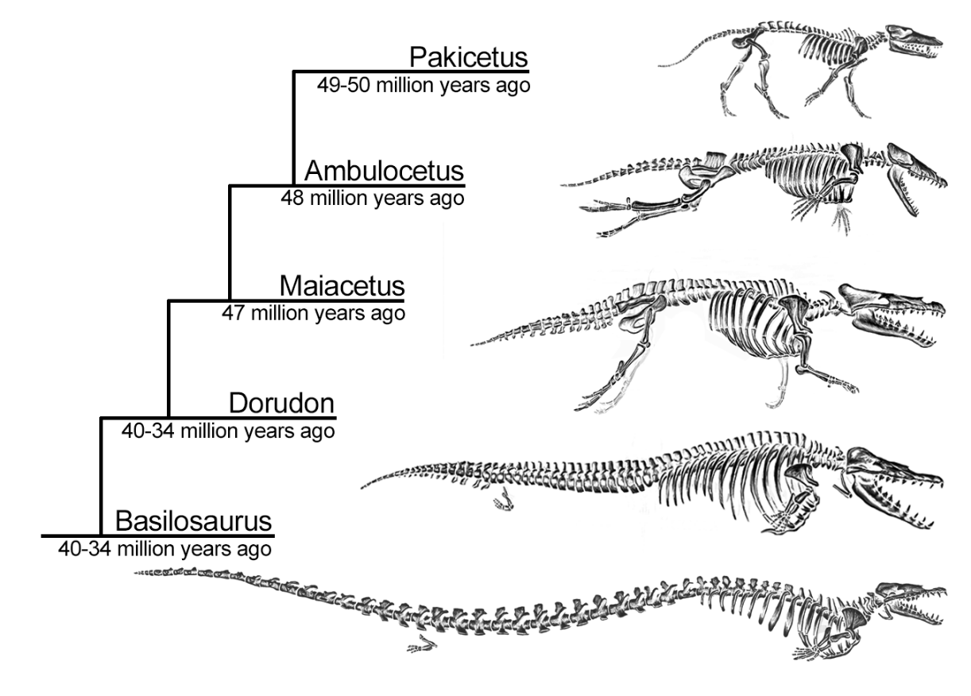
Practice Questions
The following diagram shows the evolution of whale ancestors between 49 and 34 million years
Identify the type of evolution. Provide three supporting explanations (4 marks)

Slide 8
Practice Questions
Explain how speciation and macro-evolutionary changes result from an accumulation of micro-evolutionary changes over time (10 marks)
Describe how micro-evolution could result in the development of salt tolerance in a species of plant (10 marks)

Slide 9
Topic Question 2: Define the different patterns of evolution and provide examples of each
Pattern of evolution | Definition | Diagram | Example

Slide 10
Topic Question 3: Define adaptive radiation and provide examples of adaptive radiation

Slide 11
Sum it up!
Draw a Concept map or mind map of evolution making links to heredity to summarise what you have learnt

